Slide 1
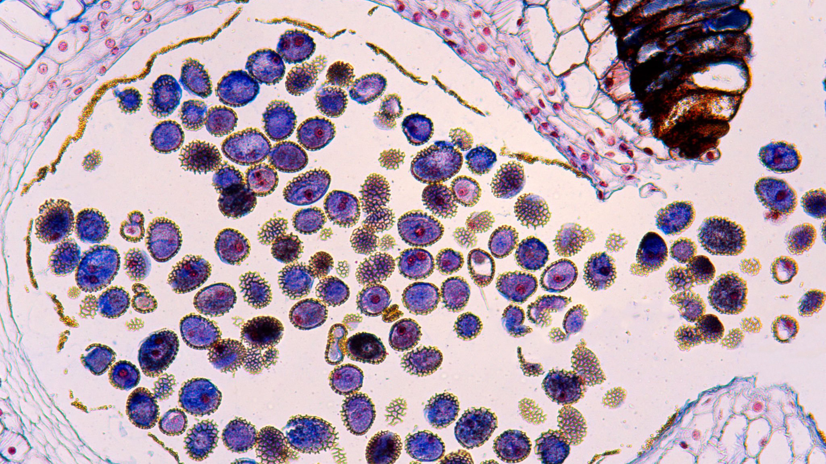
Parasite Image Classification
Ashraf Abdulkhaliq | Karim Ramzy | Mohamed Elaraby
| Saif Elshamy |Randa Hamada

Slide 2
Sky Team
Ashraf Abdulkhaliq adafadfadf
Faculty of Artificial Intelligence KSU
Mohamed Elaraby
Faculty of Artificial Intelligence KSU
Saif Elshamy
Faculty of Artificial Intelligence KSU
Karim Ramzy
Faculty of Artificial Intelligence KSU
Randa Hamada Faculty of Artificial Intelligence KSU

Slide 3

Agenda
Problem Statement
Dataset Overview
Data Pre-processing
Model Improvements

Slide 4
Agenda
Problem Statement
Dataset Overview
Data Pre-processing
Model Improvements

Slide 5
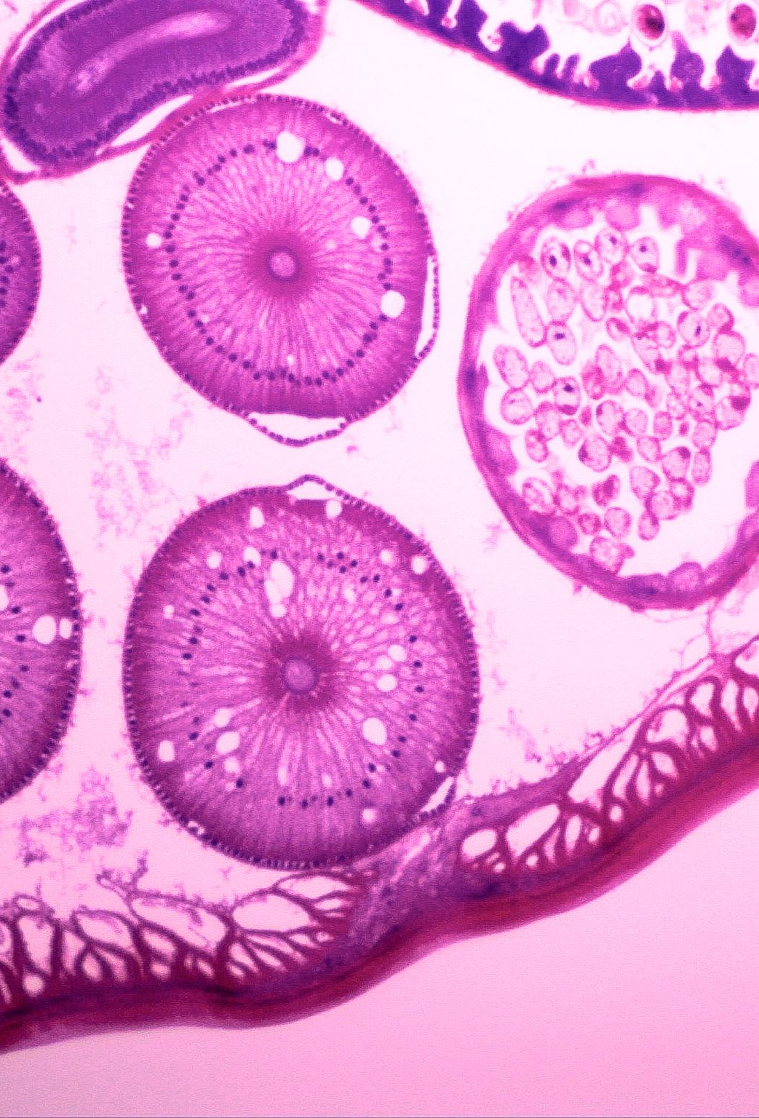
Problem Statement
Our dataset includes a wide range of microscope images showcasing different parasite types. The main task at hand is to construct a model that can effectively discern and categorize these parasites with accuracy.

Slide 6
Agenda
Problem Statement
Dataset Overview
Data Pre-processing
Model Improvements
Model Deployment Plan
Conclusion

Slide 7
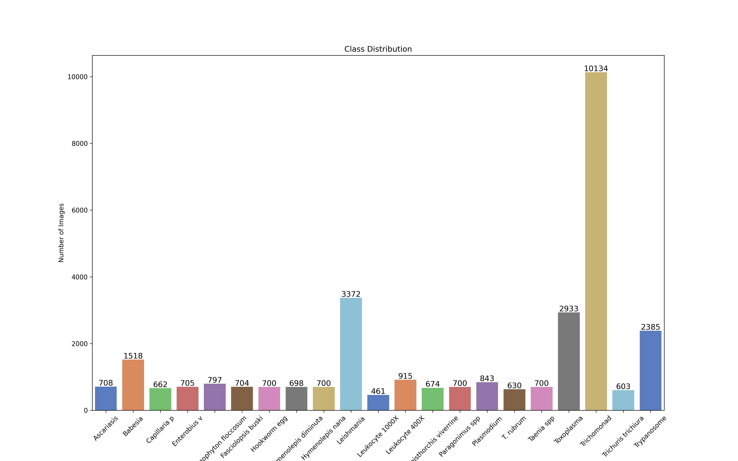
Dataset Overview
Outcomes:
Total Images: 31542 image
Total Classes: 21 class
Trichomonad class has the high number of images (majority class)!
Leukocyte class has the low number of images (minority class)!

Slide 8
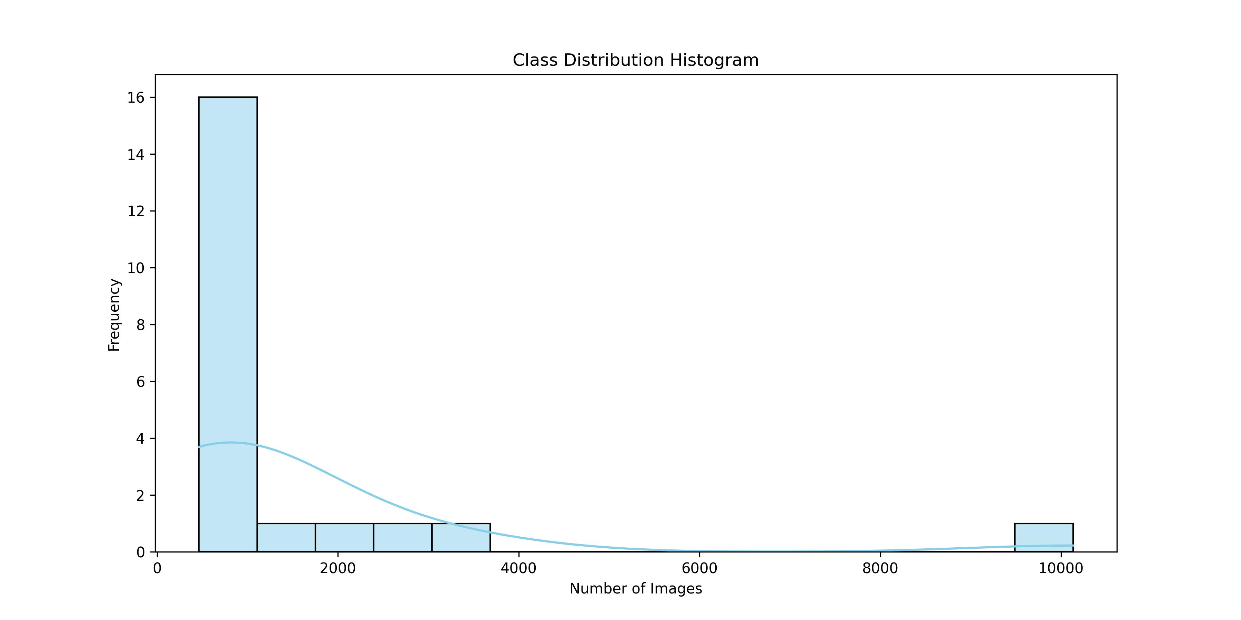
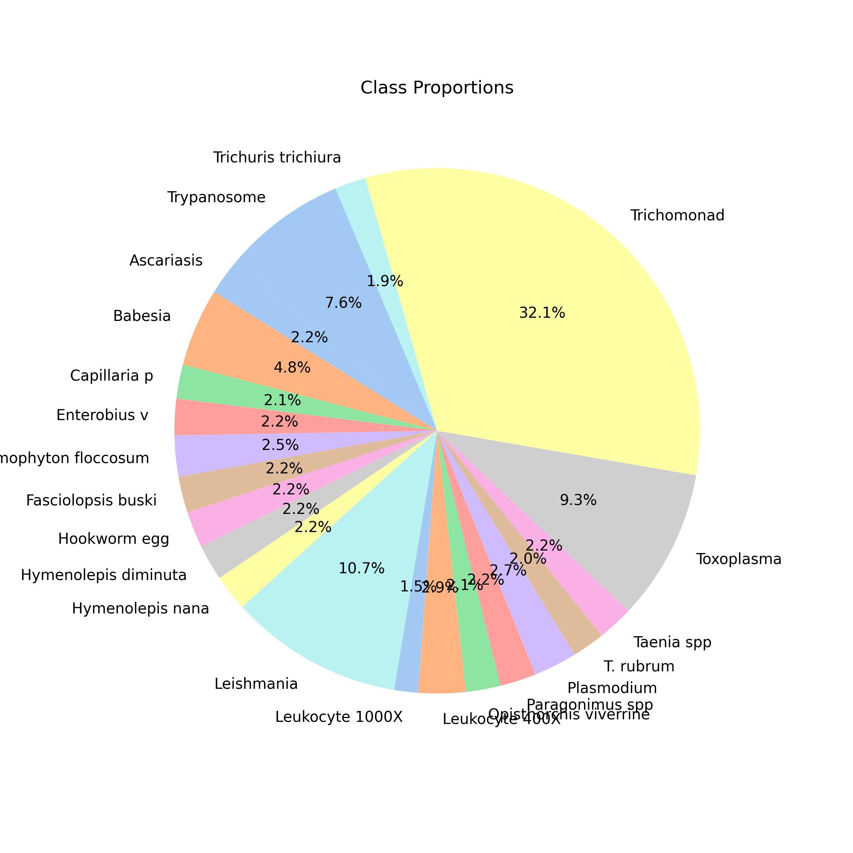
Dataset Overview (cont)
Trichomonad

Slide 9
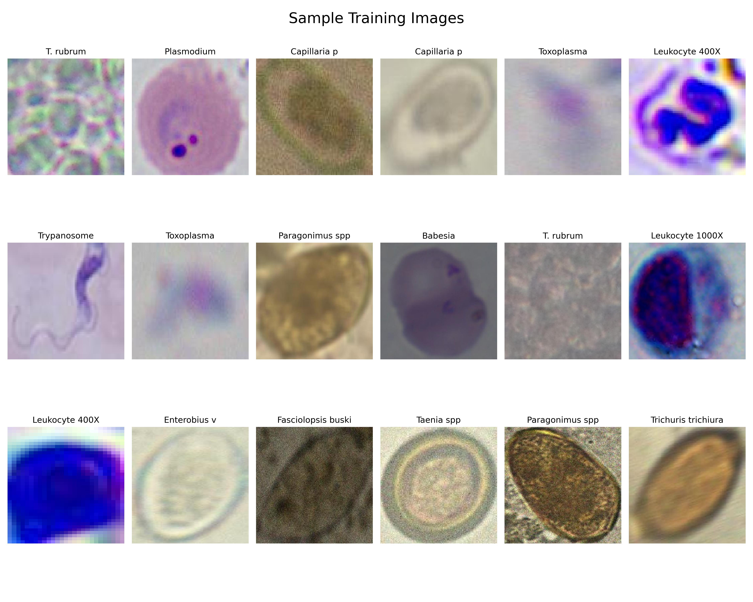
Dataset Overview (cont)

Slide 10
Agenda
Problem Statement
Dataset Overview
Data Pre-processing
Model Improvements
Model Deployment Plan
Conclusion

Slide 11
Data Pre-processing
1. Detection & Cropping
First, we have a mix of high shape images and low shape images, so we write a script to split them using their shapes by threshold 500*500 px.
Second, we took high shape images and labeled it using CVAT online tool.
Third, trained and evaluate YOLO model to detect the coordinates of the parasite in a given microscopic image.

Slide 12
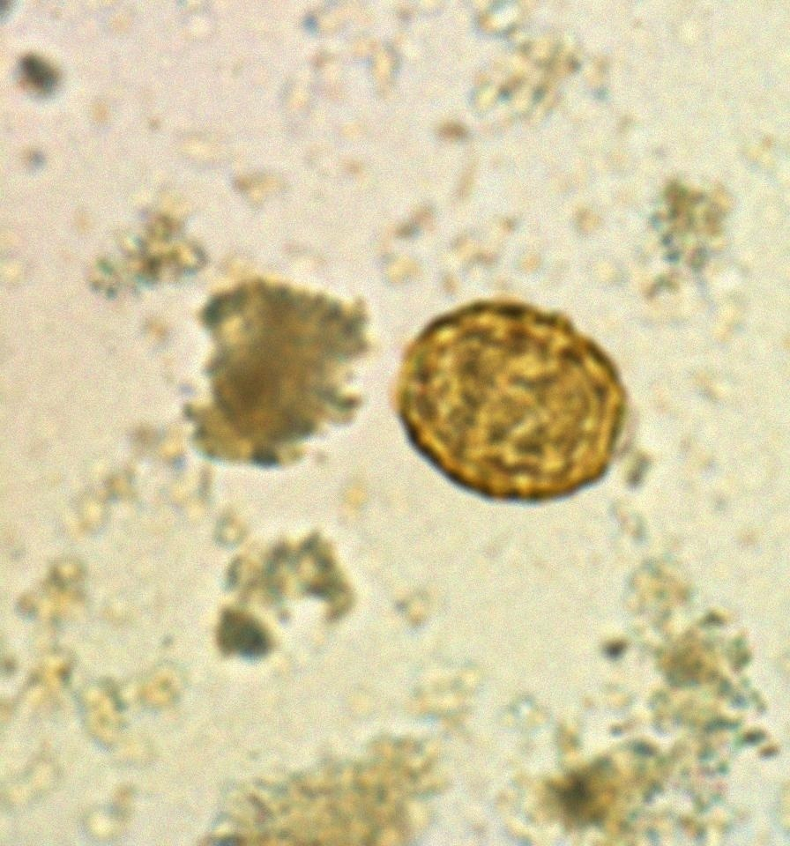
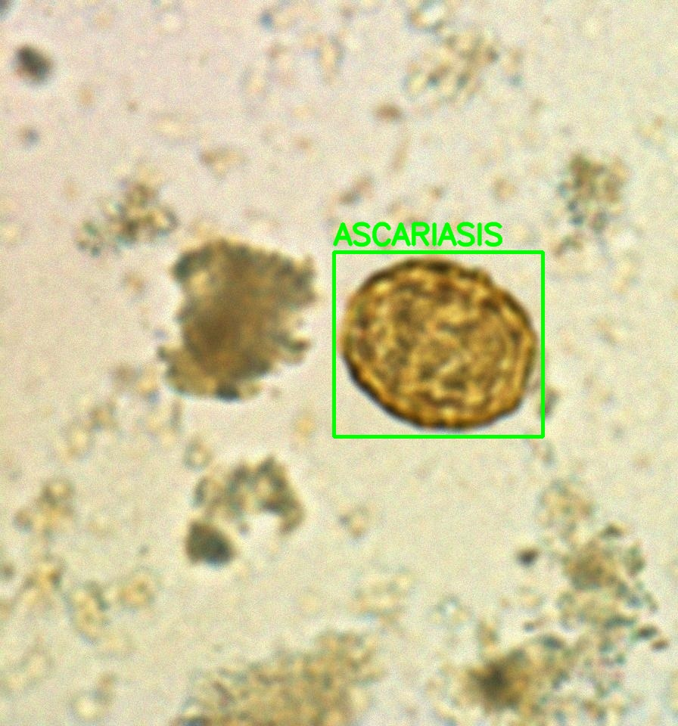
Data Pre-processing
1. Detection & Cropping

Slide 13
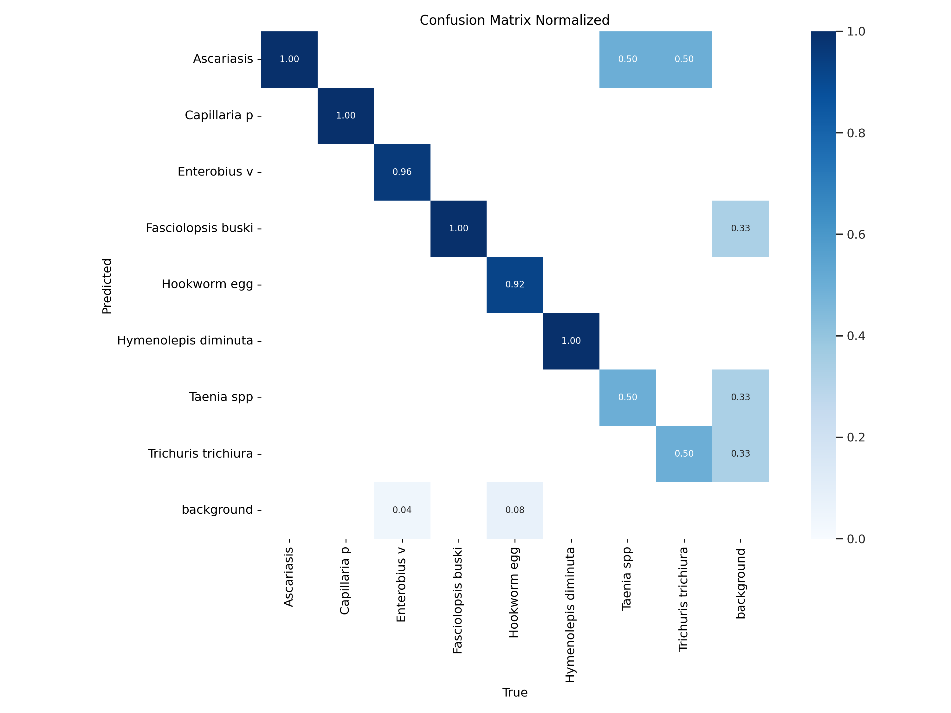
Data Pre-processing
1. Detection & Cropping

Slide 14
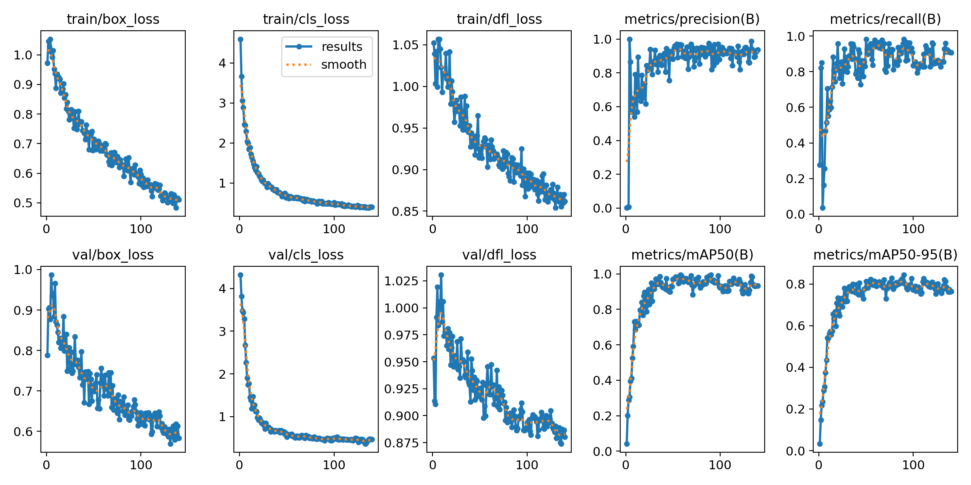
Data Pre-processing
1. Detection & Cropping

Slide 15
Data Pre-processing
2. Over vs. Under Sampling
Over Sampling
Under Sampling
Over sampling aims to balance the class distribution by increasing the number of instances in the minority class.
Minority class in our data is Leukocyte with the 461 samples.
Under sampling aims to balance the class distribution by reducing the number of instances in the majority class.
Majority class in our data is Trichomonad with 10134 samples.

Slide 16
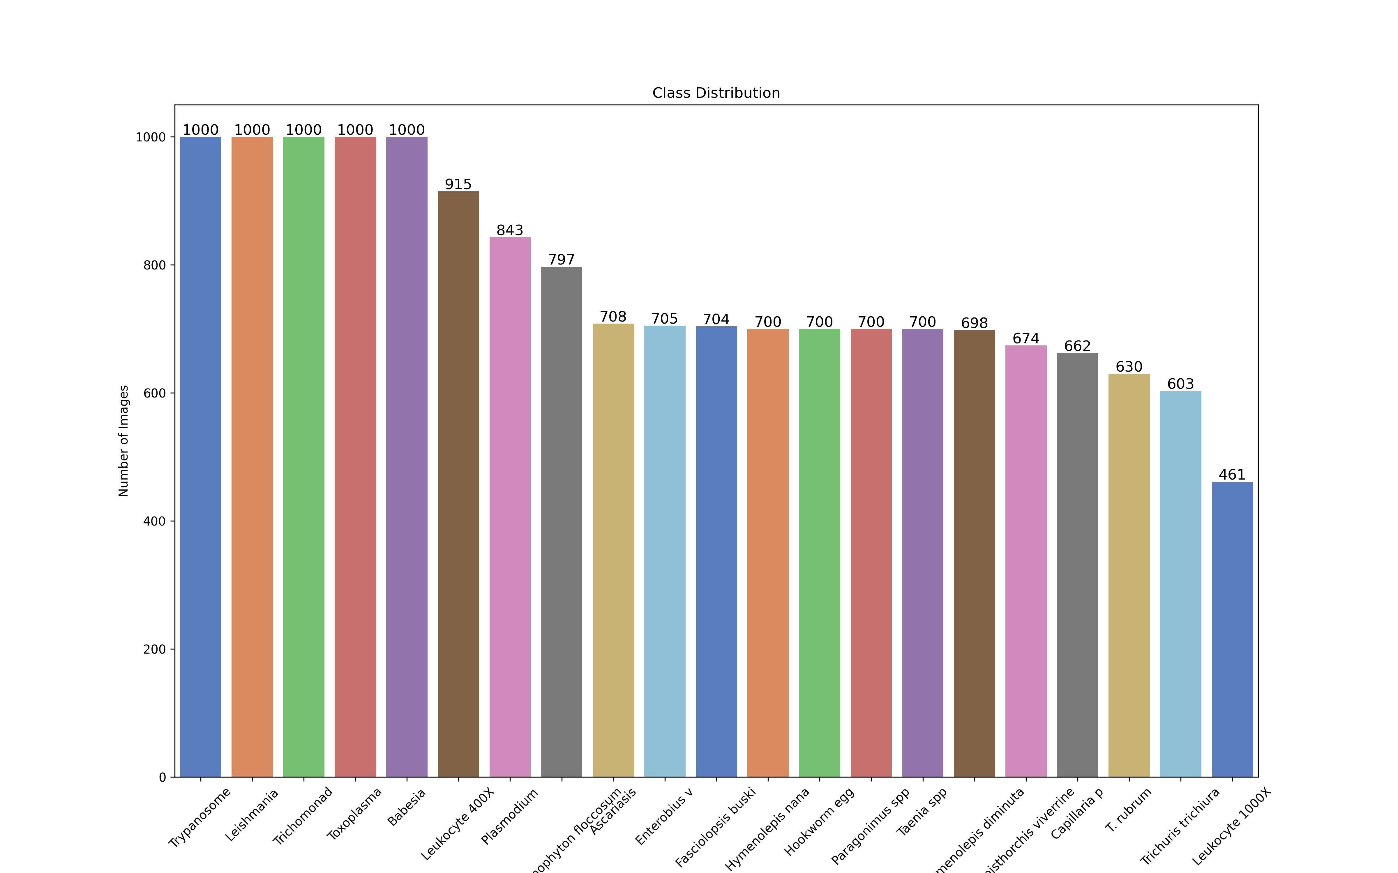
After Class Distribution

Slide 17
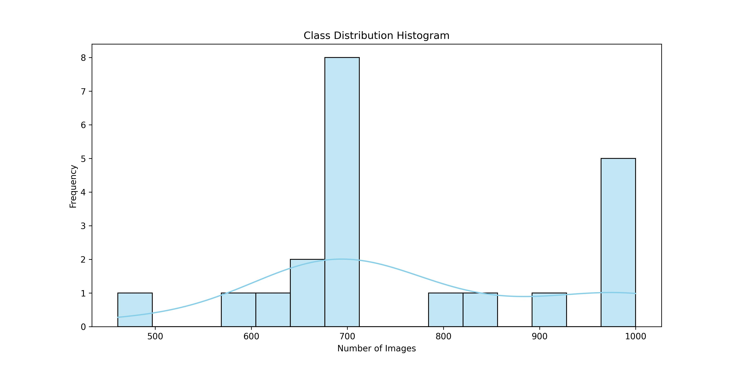
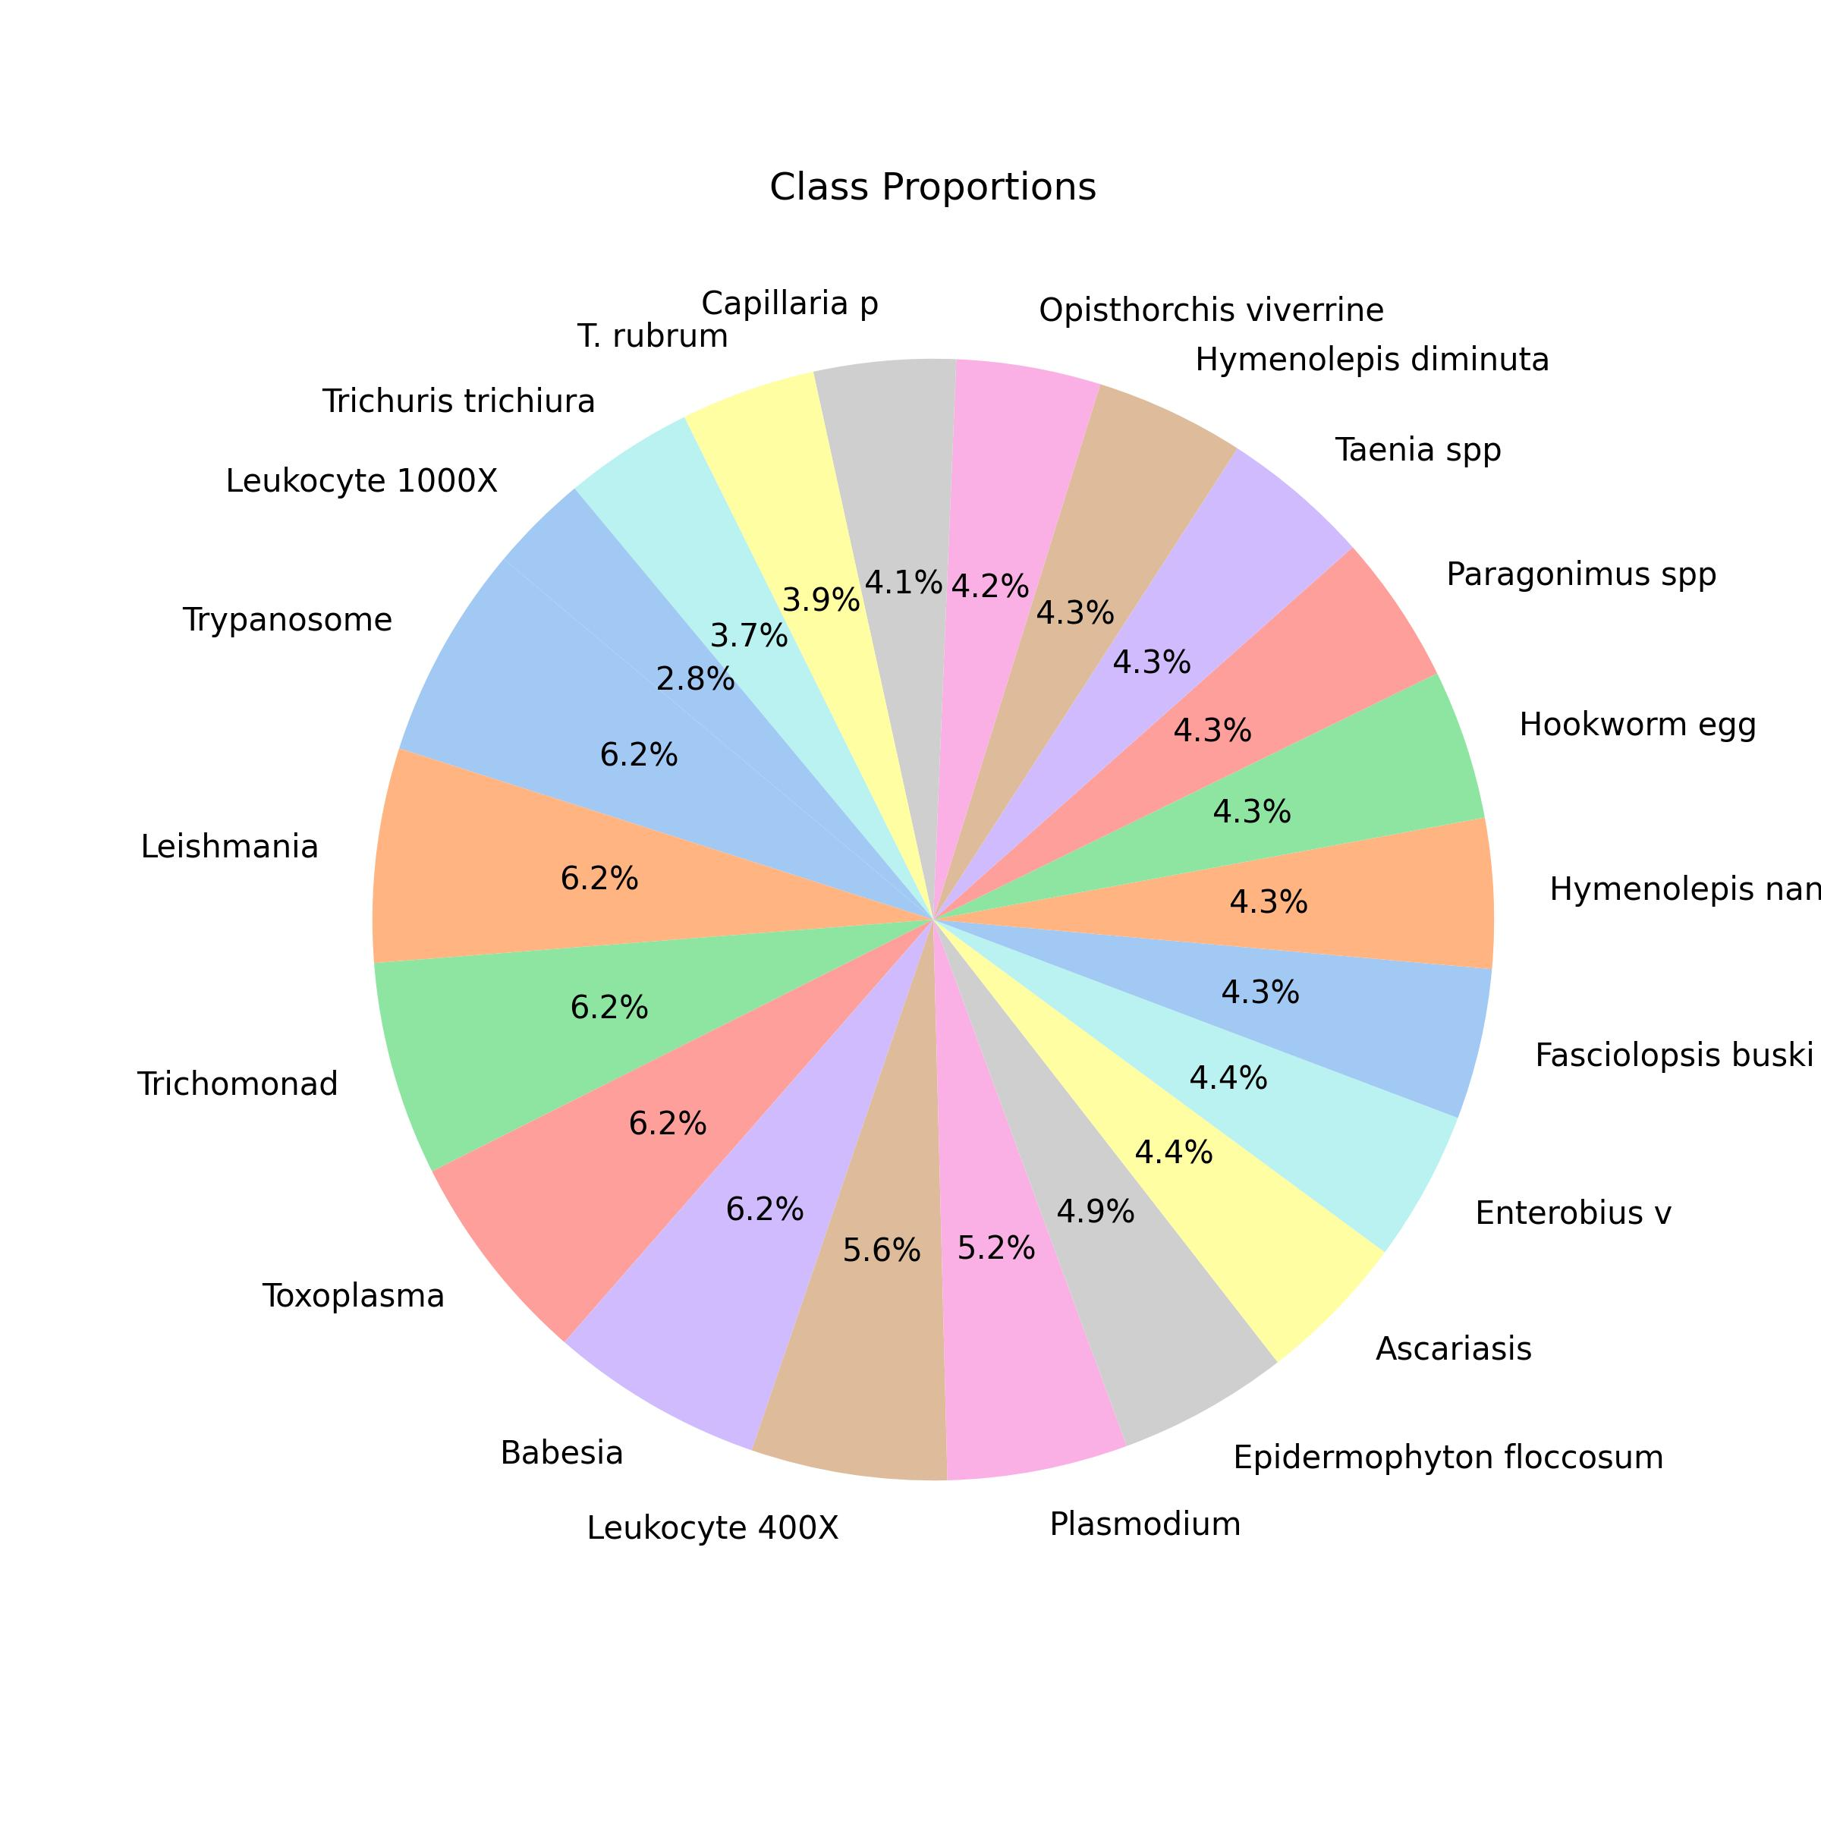
[After] Histogram - Class Distribution

Slide 18
Data Pre-processing
3. TensorFlow Pre-processing magic method
Image Resize
Ensuring that the input image is resized to meet the specific input size requirements of the model.
Image Scale
Scaling the pixel values between (0, 1)
Channel Reordering
Converting from RGB to BGR, depending on the model's backend requirements.
Data Range Adjustment
Modifying the range of pixel values to align with the expected input range of the model. Typical [0, 255] range to [-1, 1] or [0, 1] range.

Slide 19
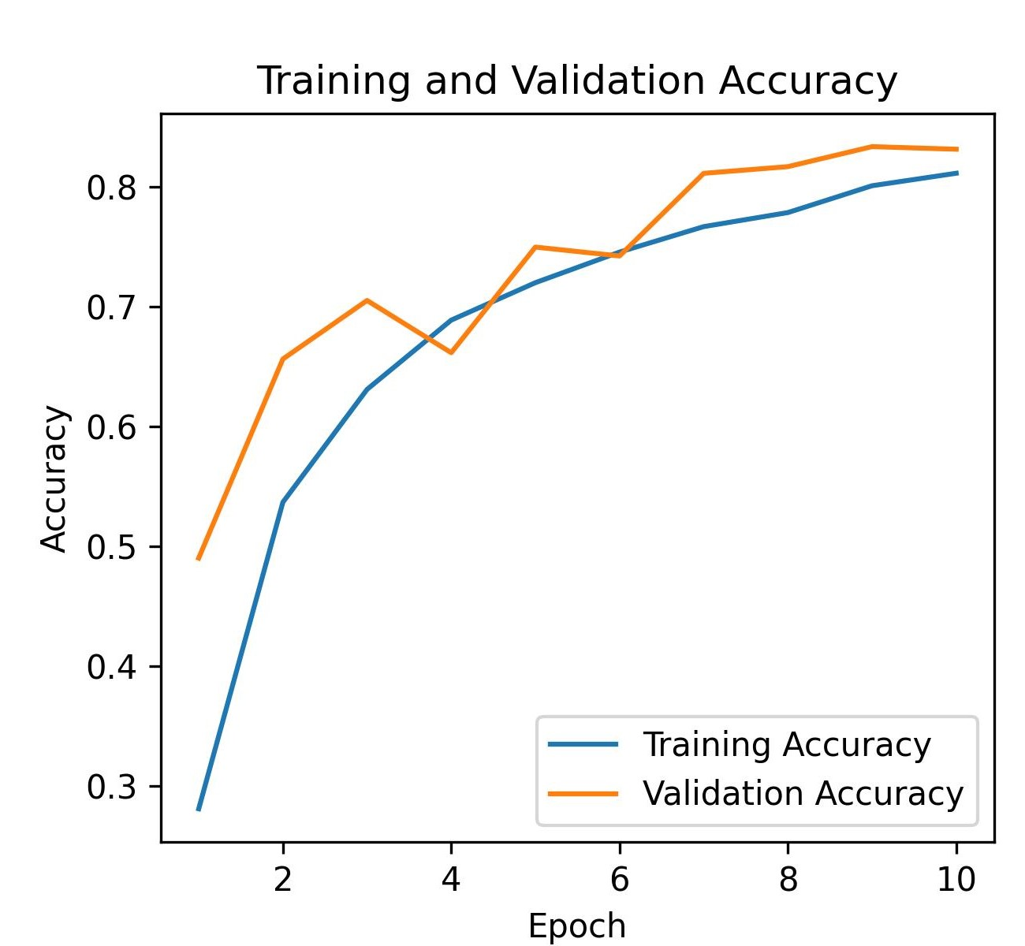
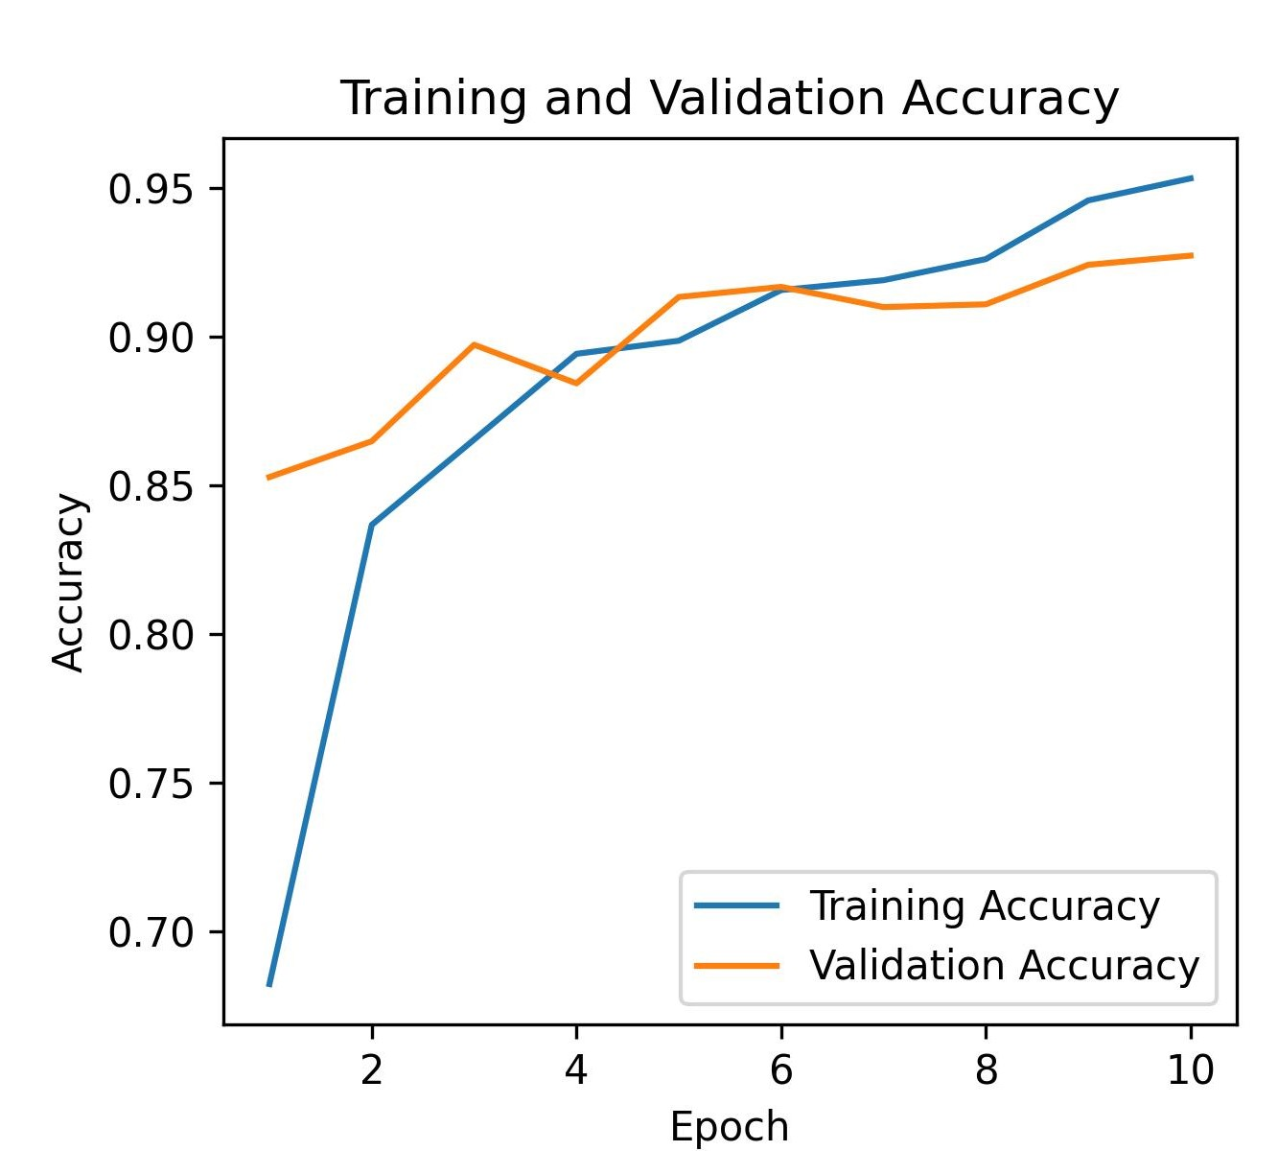
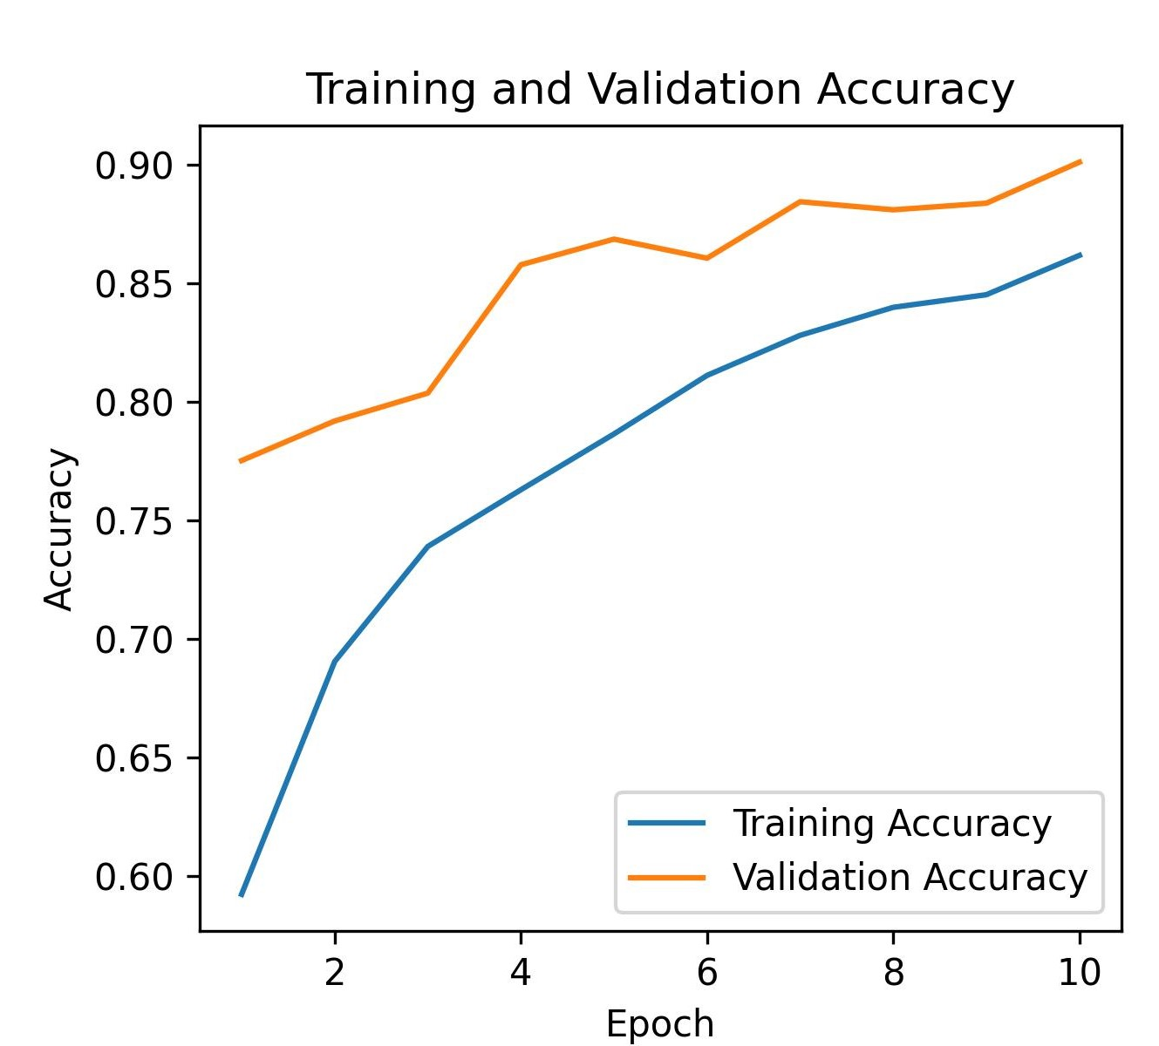
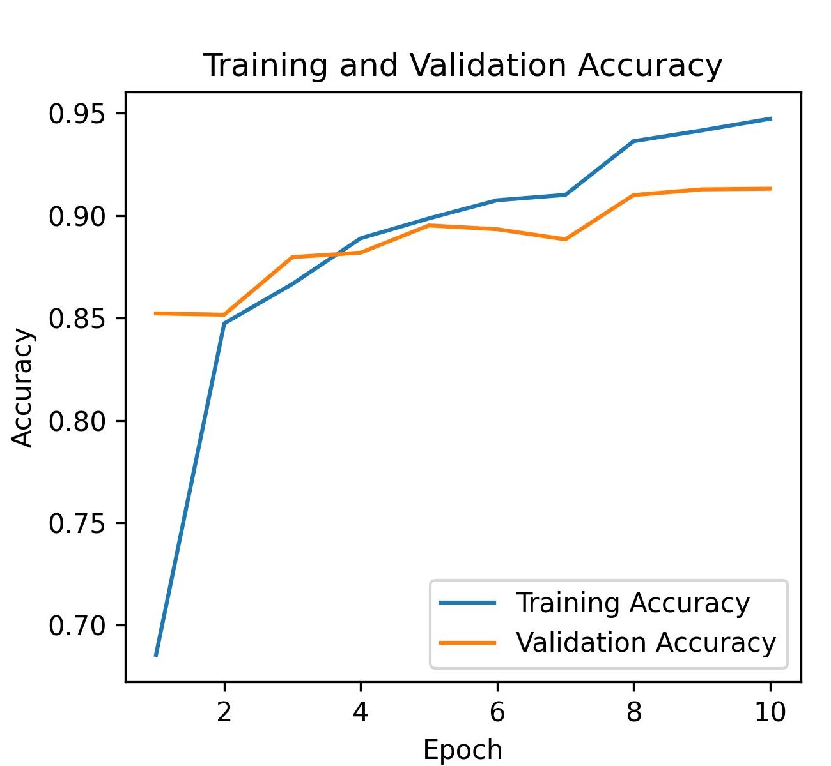
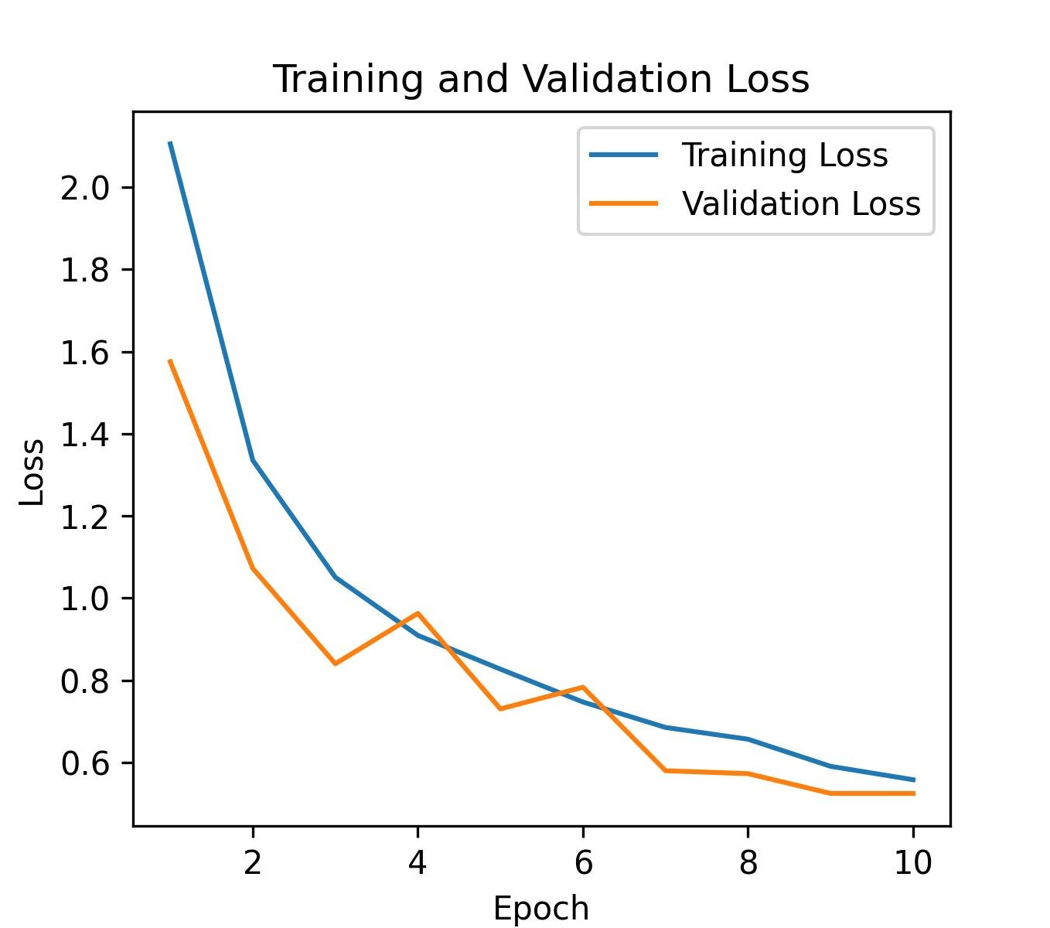
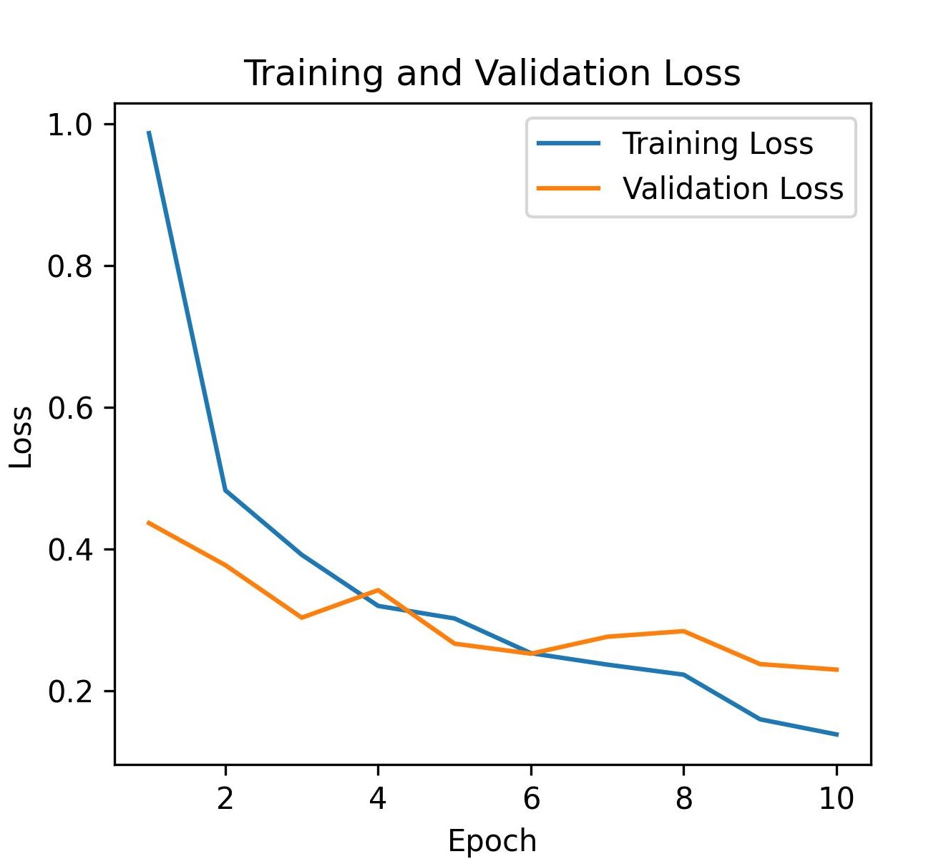
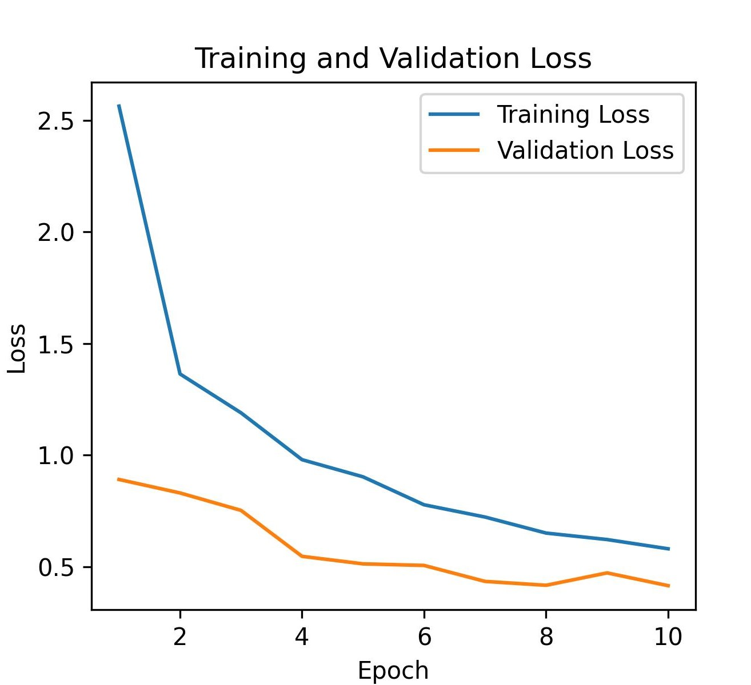
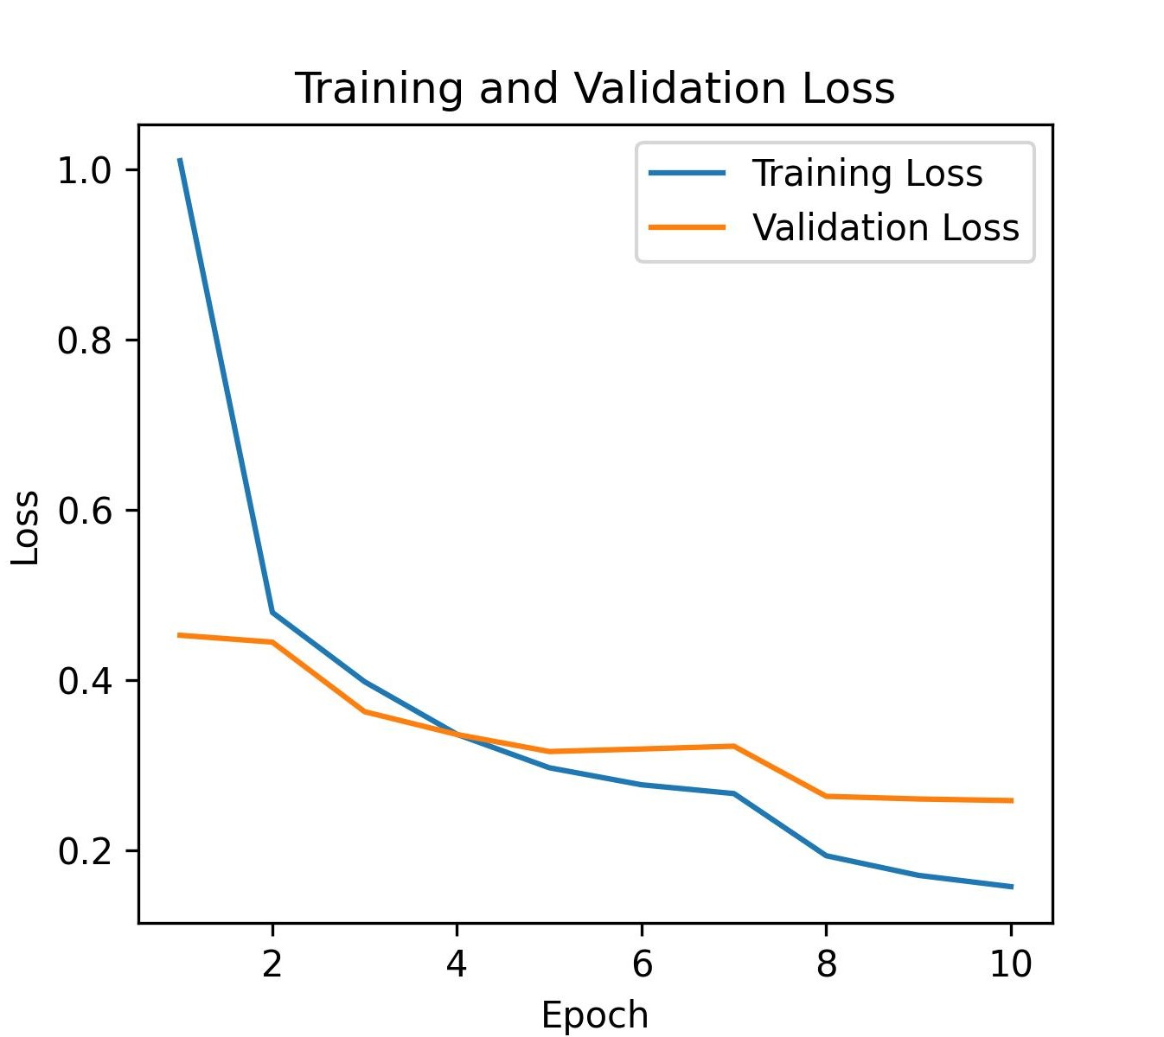
Models Training Evaluation
Custom CNN ResNet50 ResNet50V2 Xception

Slide 20
Agenda
Problem Statement
Dataset Overview
Data Pre-processing
Model Improvements
Model Deployment Plan
Conclusion

Slide 21
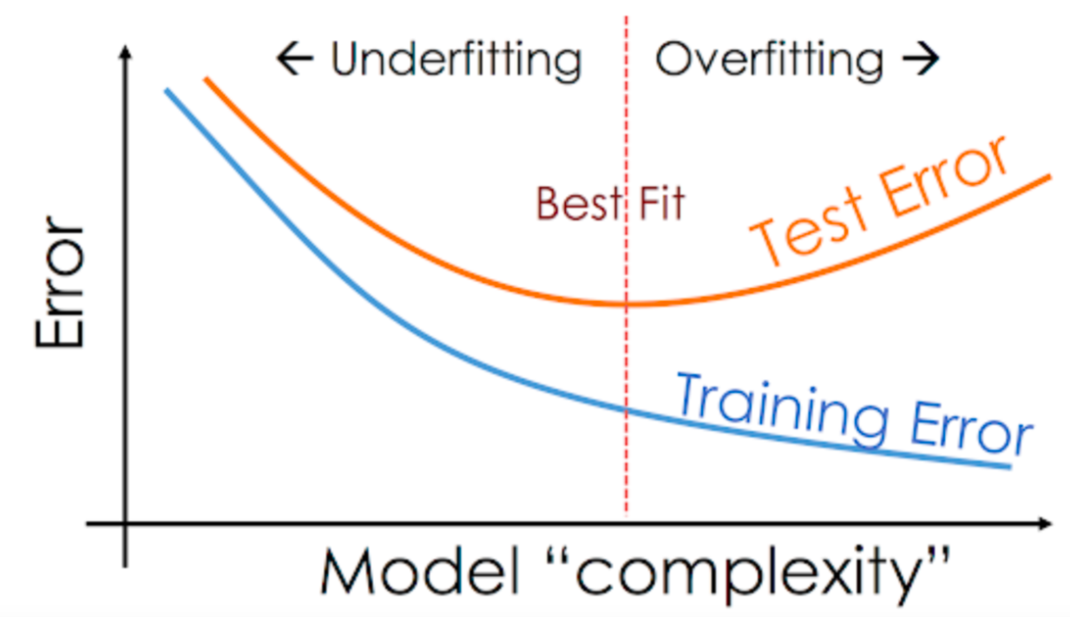
Model Improvements
In Overfitting, the model tries to learn too many details in the training data along with the noise from the training data. As a result, the model performance is very poor on unseen or test datasets.

Slide 22
Handle Overfitting
Reduce the Model Complexity
Removing some layers.
Weight Regularization
Data Augmentation
Reducing the penalizes the network’s large weights.
Reducing the number of neurons.
increase the size of the training

Slide 23
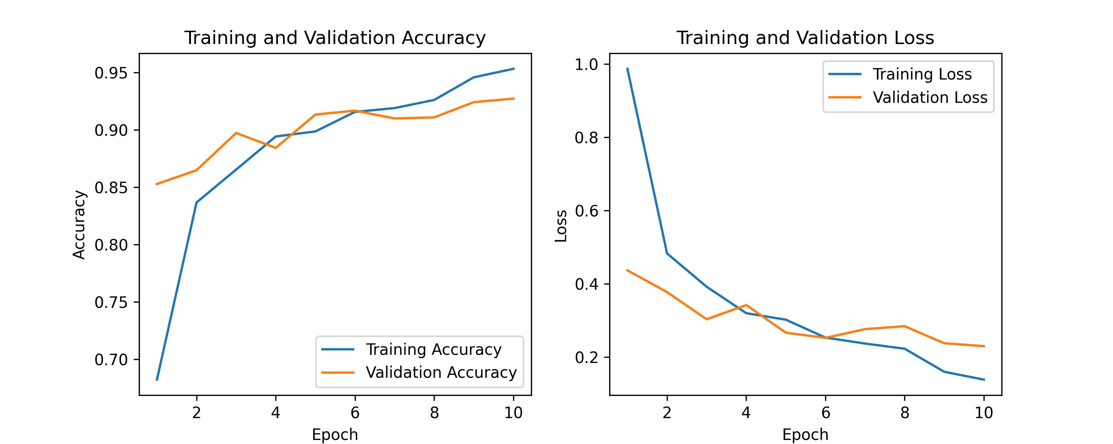
Best Model (ResNet50)

Slide 24

thanks

